Slide 1
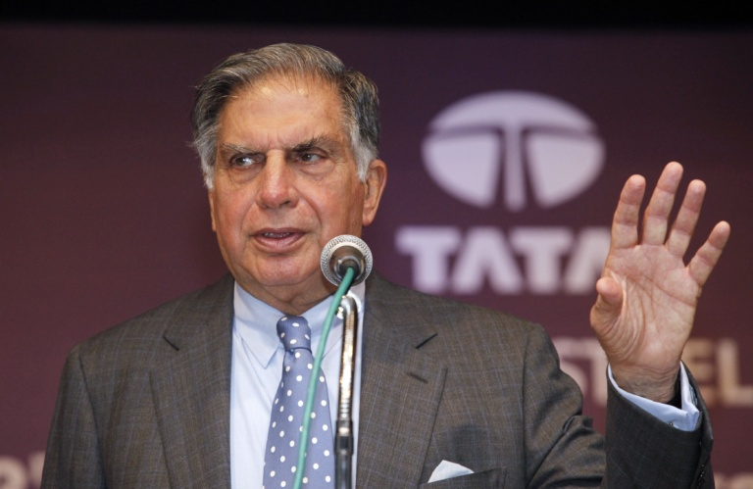
Management and Working Style of Ratan Tata.
My Understanding of Ratan TATA.
His leadership styles helped him to run the business smoothly. Mr. Ratan is an unwearying individual. He never keeps his work undone for tomorrow. He is also capable of bringing tremendous energy in any matter, be it finance, technical stuff or business. He also created a structure in his organization through which his company transfers a huge amount of responsibility from the center to states. As a result, different types of leaders come out from different business environments.
A Visionary Leader: He is a true visionary leader and he knows where he is right and where he wants his company to be. When he joined the company, no one knew this company would run outside of India. But Ratan Tata made it possible with his vision and now half of Tata’s revenue comes from global.

Slide 2
Ability to Motivate Others: He has an eminent quality to inspire and motivate people. He can be able to motivate his employees in order to get the job done effectively and efficiently. He has also made it sure by his leadership quality that employees and management should be stick to the company’s values.
Humility: Ratan Tata has remained a humble man throughout his career. Staying humble made him a great leader and he always put himself grounded. As a result, he could easily serve his organization and its employees according to their interests.
A Man of Values: He believes that a company should be run on principles, not on personalities. Mr. Ratan Tata and his company Tata had some core values which they followed all through their journey. He is also well known for promoting financial transparency and intense vetting for grants for projects which help the needy people. Furthermore, public safety and welfare are some of their core values which they always followed. This leadership quality has made them one of the most trusted groups worldwide.
A Man with Positive Attitude: He always has a positive attitude and he puts a smile on his face in every situation. He always possesses a positive outlook towards any difficult situation. He always tries to be a doer, not a criticizer.
Risk Taker: He always believes in taking the risk. He thinks that life is not lived unless he takes chances and learns how to survive the odds of new challenges. Once he said, “I don’t believe in making the right decisions. I take decisions and make them right.”
A Man with Promise: He is a man of keeping the promise. For example, one of his pet projects Nano was mired in controversy about land acquisition for the factory. After the protest of farmers in Singur, West Bengal, his company had to pull out of the state. But after all these happenings, He kept his promise run this project. Tata was shifted to Gujarat and delivered its promise to build the cheapest car.

